Slide 1
Robo-advisory portfolio design
Adwaaiit Pande & Ayushi Mishra
MBA680 Behavioral Finance · Assignment 2
EUT vs SP/A Behavioral Portfolio Theory, with personality
Notes:
[ADWAAIIT · ~0:20]
Good morning. I'm Adwaaiit, and this is Ayushi. For Assignment 2 we acted as personal investment advisors to five classmates, and then built the robo-advisor that automates the whole process. I'll take you through how we measured everyone's preferences; Ayushi will take the results and the advice.

Slide 2
Our approach
Brief: advise a peer group on a portfolio as a personal advisor, then automate it as a robo-advisory product
5 classmates surveyed; each person's 20 choices become a utility and a value function
Portfolios built on our Problem 1 universe: 66 NSE stocks, 3-year covariance, rf 6.75%
Measure
Steps 2–3: survey risk, time and personality
Model
Step 4: Bayesian engine estimates
utility and value functions
Recommend
Steps 5–6: EUT vs SP/A-BPT portfolios, personality overlay
Adwaaiit
Notes:
[ADWAAIIT · ~0:45]
Our approach has three stages. Measure — Steps 2 and 3 — we survey risk and time preferences and personality. Model — Step 4 — an adaptive engine turns each person's 20 choices into a utility function and a prospect-theory value function. Recommend — Steps 5 and 6 — we build a portfolio for each person under Expected Utility Theory and under SP/A Behavioral Portfolio Theory, on the same 66-stock NSE universe and covariance matrix from Problem Statement 1, and then layer personality on top of the advice. Everything runs live in one web portal, which Ayushi will show at the end.

Slide 3
Survey instruments
ONE SITTING, ~15 MINUTES
  All five components chained in our portal
SAY VS. DO
  Scales capture what people say; the choice task captures what they do
VALIDATED + OUR OWN
  Three published scales plus our adaptive engine (Step 4)
INSTRUMENT | ITEMS | MEASURES
Self-rating anchors | 2 | Risk willingness, patience (0–10)
Grable & Lytton (1999) | 13 | Financial risk tolerance
DOSPERT financial (Blais & Weber, 2006) | 6 | Investing vs. gambling risk-taking
BFI-2 (Soto & John, 2017) | 60 | Big Five personality, 15 facets
Adaptive choice engine (ours) | 18 + 2 | γ, λ, α, β, δ (Step 4)
Adwaaiit
Notes:
[ADWAAIIT · ~0:50]
Each respondent completes five components in one sitting, about fifteen minutes: two self-rating anchors; the 13-item Grable and Lytton risk-tolerance scale; the financial part of DOSPERT, which separates investing from gambling; the full 60-item BFI-2 for personality, as the brief asks; and our own adaptive choice task, which is Step 4. The design point: the first four tell us what people say about themselves, the last one shows what they actually choose. Where the two disagree, that is information in itself — we come back to it in Step 6.

Slide 4

Step 4: the elicitation engine
FIVE PARAMETERS, ONE MODEL
  γ curvature: u(x) = x^(1−γ)
  λ loss aversion: v(−x) = −λ·x^(1−γ)
  α Prelec weighting: w(p) = exp(−(−ln p)^α)
  β, δ present bias, patience: D(t) = β·δ^(t/30)
EACH OF 18 QUESTIONS
  Gamble vs. sure amount, or now vs. later
  Bayes update over 7,776 parameter combinations
  Next question = largest expected information gain
  2 hidden repeats; Empirical-Bayes pooling (≥30% own weight)
Adwaaiit
Notes:
[ADWAAIIT · ~1:00]
Step 4 is the core of the project. Every question is a choice: a gamble versus a sure amount, or money now versus more money later. We score each option with one five-parameter model — γ for curvature, λ for loss aversion, α for Prelec probability weighting, and β and δ for present bias and patience. The engine keeps a posterior over all 7,776 combinations on the grid, updates it by Bayes' rule after every answer, and asks next whichever question is expected to shrink the uncertainty the most. Two questions are secretly repeated as a consistency check. Because twenty answers is not a lot, we then shrink each person's estimate toward the group average using Empirical Bayes, always keeping at least 30% weight on the individual.

Slide 5
Utility & value functions
Shree Charan
Kshitij
Kartika
Ayushi
Adwaaiit Pande
γ ≈ 2.2 for three of us: strongly concave (curves overlap). Kshitij γ = −0.5: convex, risk-seeking.
Only Kshitij is loss-averse (λ = 1.6). With e = max(1−γ, 0.05), three curves hit the floor: near-step.
Adwaaiit
Notes:
[ADWAAIIT · ~1:00]
These are the Step 4 graphs. Left, the EUT utility function. Shree Charan, Ayushi and I sit almost on top of each other at γ around 2.2: strongly concave. Kartika is close to risk-neutral. Kshitij came out with a negative γ, so his curve is convex — risk-seeking — which classic EUT cannot handle; we floor him at 0.05 for the portfolio maths and report both numbers.
Right, the prospect-theory value function. Only Kshitij is loss-averse: a loss hurts him 1.6 times as much as an equal gain. One honest caveat: the engine floors the exponent at 0.05, so for the three of us at 2.2 the curve becomes almost a step. We know we are strongly risk-averse in the choice task, but not exactly how strongly.

Slide 6
Weighting & discounting
Shree Charan
Kshitij
Kartika
Ayushi
Adwaaiit Pande
Kshitij and Shree Charan over-weight rare events: a 5% chance feels like 21% and 16%.
₹1 in a year is worth ₹0.18 today to Kshitij, ₹0.70 to Adwaaiit (who self-rated patience 4/10).
Adwaaiit
Notes:
[ADWAAIIT · ~0:50]
The other two functions. Probability weighting: Kshitij and Shree Charan show the classic inverse-S — they treat a 5% chance as if it were 21% and 16%, the lottery-ticket effect. Kartika weights probabilities objectively. Time preference: the drop just after zero is present bias. Kshitij is the most impatient — a rupee one year away is worth about 18 paise today to him. I am the most patient at about 70 paise, even though I rated my own patience 4 out of 10. That is our second gap between what people say and what they choose.
With that, over to Ayushi for the results.

Slide 7
Results
& advice
Notes:
[AYUSHI · ~0:10]
Thanks, Adwaaiit. So what do these preferences mean for each person's portfolio?

Slide 8
Survey outcomes
RESPONDENT | GRABLE-LYTTON | SELF RISK / PATIENCE | γ | λ | α | β | δ | NEG. EMOT. | RETEST
Shree Charan | 27 | 7 / 7 | 2.21 | 1.000 | 0.57 | 0.80 | 0.944 | 3.00 | 1.0
Kshitij | 31 | 3 / 6 | -0.50 | 1.600 | 0.40 | 0.63 | 0.900 | 3.00 | 1.0
Kartika | 31 | 4 / 7 | 0.20 | 1.000 | 1.00 | 0.90 | 0.930 | 2.17 | 1.0
Ayushi | 35 | 7 / 7 | 2.21 | 1.009 | 1.09 | 0.76 | 0.945 | 3.00 | 0.5
Adwaaiit Pande | 40 | 10 / 4 | 2.19 | 1.015 | 1.25 | 0.94 | 0.976 | 2.75 | 1.0
Flags we report, not hide: Shree Charan's BFI-2 is exactly 3.00 on all five domains (likely straight-lining) · Ayushi's retest consistency is 0.5 · Adwaaiit self-rates risk 10/10 with the top Grable-Lytton score (40), yet his choices give γ ≈ 2.2
γ, λ pooled by Empirical Bayes; α, β, δ posterior means. Kshitij's γ = −0.50 is floored to 0.05 for portfolio maths.
Ayushi
Notes:
[AYUSHI · ~0:50]
This is the full outcome table for the five of us. Grable–Lytton scores run from 27 to 40. The pooled γ and λ drive the portfolios; α, β and δ describe how each person perceives probabilities and time. Three flags we report rather than hide: Shree Charan's BFI-2 is exactly 3.00 on all five domains, which looks like straight-lining; my own retest consistency is 0.5, so one of my two repeated questions flipped; and Adwaaiit rates his risk tolerance 10 out of 10 and has the top Grable–Lytton score, yet his choices give a γ of 2.2.

Slide 9
EUT: one portfolio for all
Shree Charan
Kshitij
Kartika
Ayushi
Adwaaiit
100%
in equities for all five: the long-only cap binds for everyone
13.21% / 16.08%
same expected return and volatility for all (two-fund separation)
γ > 2.5
needed before EUT holds any cash; our highest pooled γ is 2.21
Caveat: the engine identifies γ only as ≥ ~1; at γ = 3.0 the share would be 83%.
Solid: long-only risky share · dashed: unclipped 2.5/γ · dots: our five (Kshitij at floored γ = 0.05; three overlap at γ ≈ 2.2)
Ayushi
Notes:
[AYUSHI · ~1:00]
Under EUT, the share of wealth in the risky tangency portfolio is the market price of risk divided by γ — 2.5 over γ in our universe — capped at 100% because the mandate is long-only, no leverage. Everyone's γ is below 2.5, so everyone hits the cap: 100% in the same tangency portfolio, 13.21% expected return and 16.08% volatility. That is two-fund separation at work: EUT simply cannot personalise this group. Someone would need γ above 2.5 before EUT holds any cash at all. And given the identification caveat Adwaaiit mentioned, at γ of 3 the share would be 83%, so for the three people at 2.2 this result is conditional.

Slide 10
SP/A-BPT: λ sets the mix
RESPONDENT | λ | SAFETY | RETURN | VOL.
Shree Charan | 1.000 | 30.0% | 16.19% | 29.46%
Kshitij | 1.600 | 40.0% | 15.77% | 27.12%
Kartika | 1.000 | 30.0% | 16.19% | 29.46%
Ayushi | 1.009 | 30.2% | 16.19% | 29.42%
Adwaaiit | 1.015 | 30.3% | 16.18% | 29.40%
Safety layer: Roy safety-first above rf 6.75%
Aspiration layer: safety-first above the 75th percentile of μ
Same two building blocks for everyone; only the mix is personal.
Ayushi
Notes:
[AYUSHI · ~1:00]
SP/A-BPT does differentiate the group. Each person holds two mental accounts: a safety layer that maximises Roy's safety-first ratio above the 6.75% risk-free rate, and an aspiration layer that aims above the 75th percentile of expected returns. How money splits between the two comes from loss aversion: 30% in safety at λ of 1, rising to 80% at λ of 4. Kshitij, our only loss-averse investor, gets 40% in safety, the lowest expected return at 15.77% and the lowest volatility at 27.12%. Shree Charan and Kartika get 30%; Adwaaiit and I sit just above 30%. One subtlety: the two building blocks are identical for everyone — the personalisation is entirely in the mix.

Slide 11
Personality in the advice
Principle: personality changes how we advise and how much we trust the numbers, never the portfolio weights (those stay driven by γ and λ).
NEGATIVE EMOTIONALITY × λ
SAY VS. DO GAPS
Both high → lead with drawdown alerts and reassurance. They disagree → flag for a human follow-up.
Self-report far from revealed γ → a short conversation before finalising, never a silent average.
None of our five crosses the 3.5 threshold; the rule is built and tested for a larger cohort.
Adwaaiit: risk 10/10, top Grable-Lytton score (40), yet γ ≈ 2.2.
DATA-QUALITY SIGNALS
OPENNESS & CONSCIENTIOUSNESS
Flat BFI-2 profile or low retest → lower confidence: re-survey, or a more conservative default.
Openness → comfort with two mental accounts. Conscientiousness → will they keep rebalancing?
Shree Charan: 3.00 on all five domains. Ayushi: retest 0.5.
Kartika: open (3.17) but less conscientious (2.83) → automate her rebalancing.
Ayushi
Notes:
[AYUSHI · ~1:00]
Step 6: how personality should enter the advice. Our principle is that personality changes how we advise and how much we trust the numbers, not the portfolio weights, which stay driven by γ and λ. Four rules. Negative Emotionality is checked against λ: if both are high, we lead with drawdown communication; if they disagree, a human follows up. Gaps between self-report and choices, like Adwaaiit's, trigger a short conversation rather than being averaged away. Flat personality profiles or low retest scores, like Shree Charan's and mine, lower our confidence and call for a re-survey or a more conservative default. And Openness and Conscientiousness tell us whether a client will accept two mental accounts and keep rebalancing them — Kartika is open but less conscientious, so her plan should rebalance automatically.

Slide 12
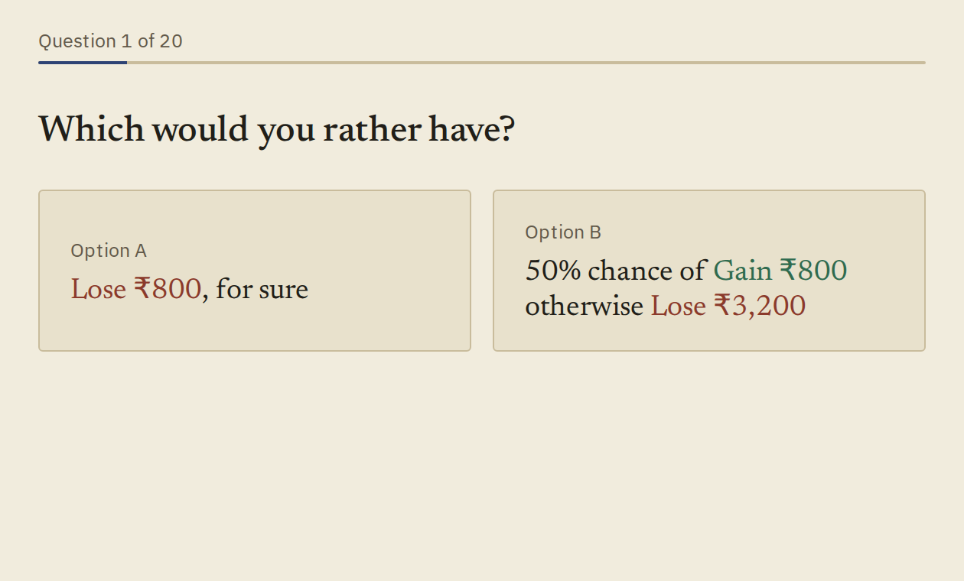
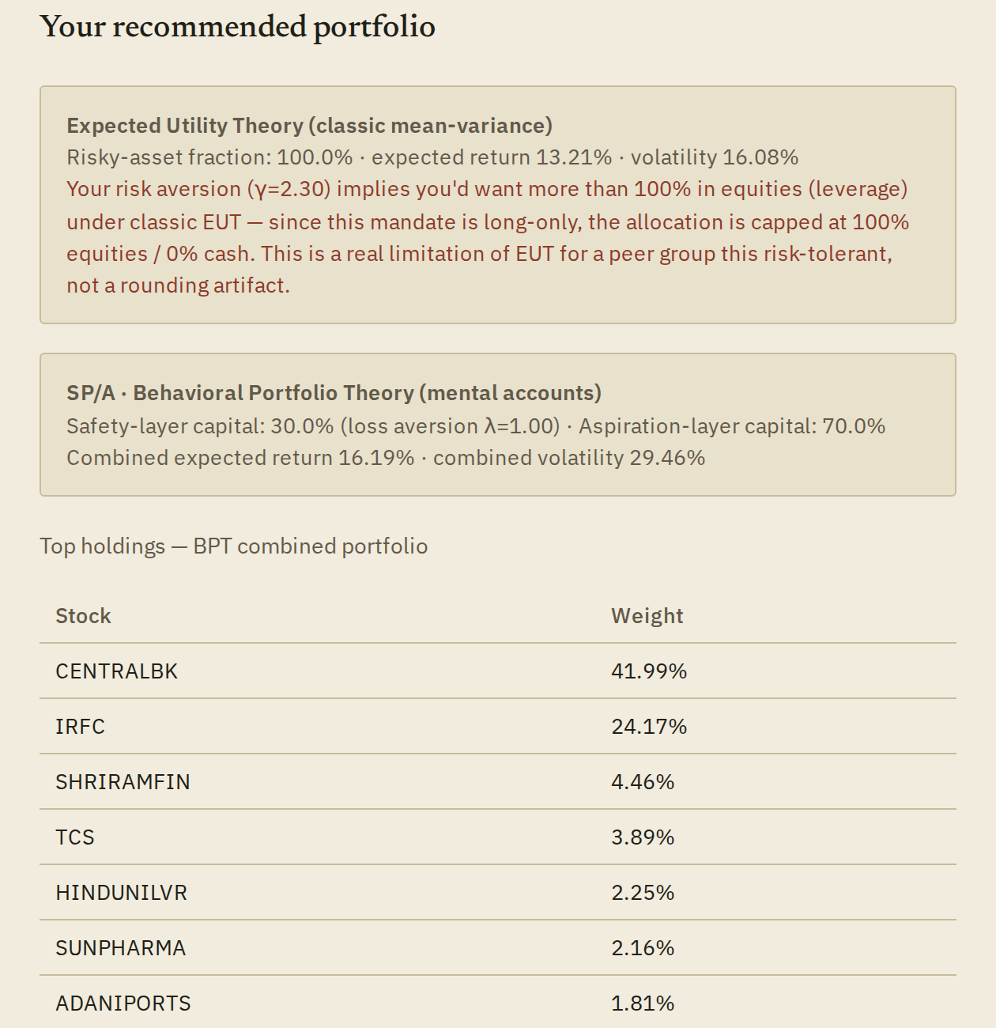
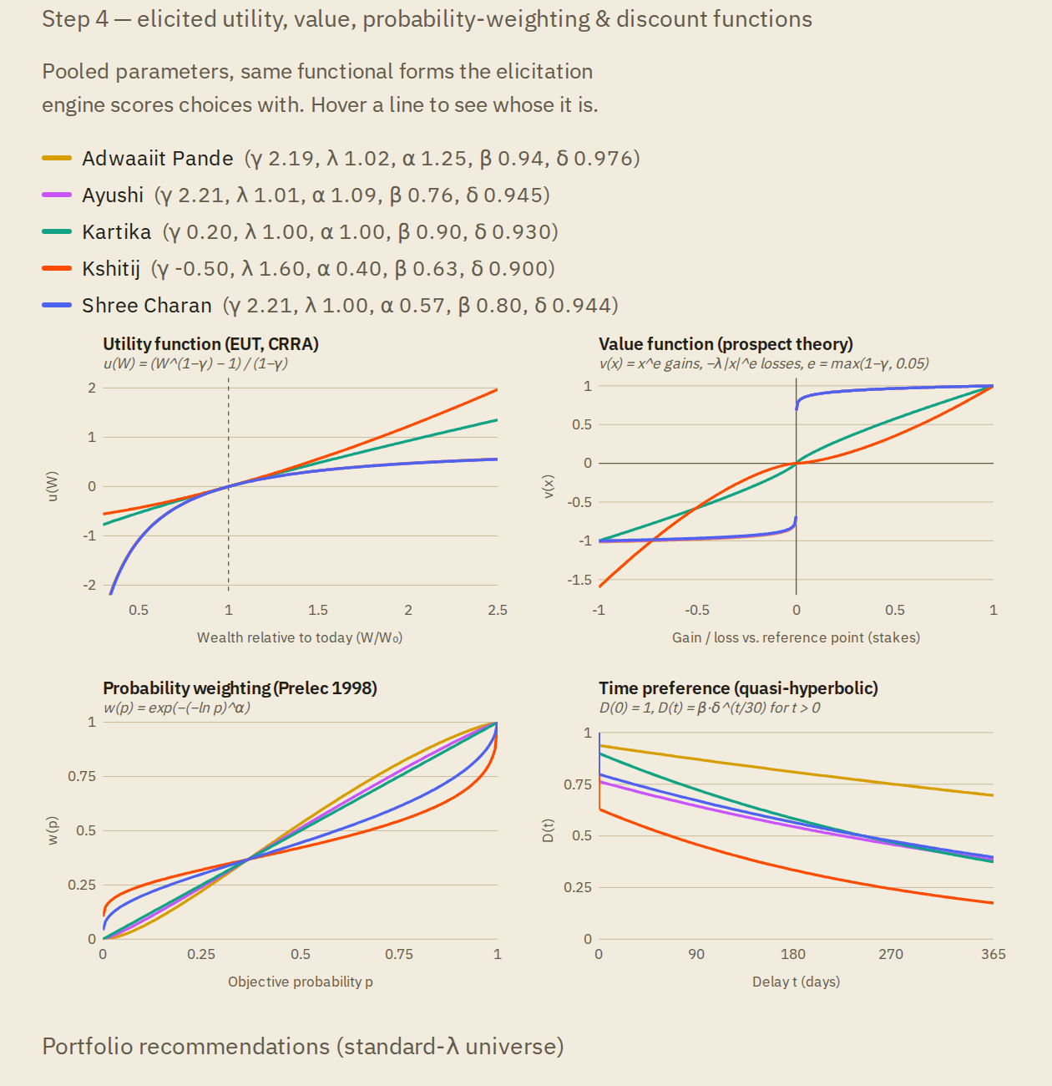
The robo-advisory portal
1 Client answers 20 adaptive choices (plus 4 scales), ~15 min
2 Instant EUT + BPT portfolio, holdings and own curves
3 Evaluator view: all 5 clients, instruments and maths pre-loaded
Deployed on Vercel · runs fully in the browser · JavaScript checked against our Python pipeline (numbers match to 3+ decimals)
Live at mba680-robo-advisor.vercel.app (add #evaluate for the full project view)
Ayushi
Notes:
[AYUSHI · ~0:45]
Deliverable (b) is this portal. A client takes the survey in about fifteen minutes. The moment they finish, the browser computes their EUT and BPT portfolios, their top holdings, their own utility and value curves, and the personality-linked commentary — no server and no manual step. A separate evaluation view loads all five of our respondents, every instrument and the full maths, so the whole project can be reviewed from one link. It is deployed as a static site on Vercel, at mba680-robo-advisor.vercel.app, so anyone with the link can use it without logging in. We checked the JavaScript against our Python pipeline: the portfolio numbers match to at least three decimal places.

Slide 13
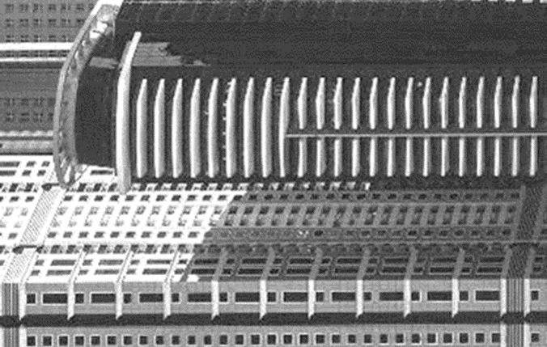
Summary
EUT alone can't personalise a young, risk-tolerant group: all five get 100% of the same tangency portfolio.
SP/A-BPT can: loss aversion sets each person's safety share, from 30% to 40%.
Personality belongs in the communication and trust layer around both models.
Limits: 5 respondents
γ identified only as ≥ ~1
μ back-solved from the Markowitz covariance
Flags reported, not dropped
Ayushi
Notes:
[AYUSHI · ~0:40]
To sum up. EUT alone cannot personalise a young, risk-tolerant group: all five of us get 100% of the same tangency portfolio. SP/A-BPT can, through loss aversion, which moves the safety share between 30 and 40%. And personality belongs in the communication and trust layer around both models, not inside the weights. Our limitations: only five respondents; γ identified only as above about 1; and expected returns back-solved from the Markowitz covariance matrix. Every data-quality flag is reported, not dropped. Next steps would be wider question stakes and a bigger peer group.

Slide 14

Thank you
Adwaaiit Pande · Ayushi Mishra
Robo-advisory portal:
mba680-robo-advisor.vercel.app
Questions?
Scan: full project view
Notes:
[BOTH · ~0:10]
Thank you — we're happy to take questions. The portal is at mba680-robo-advisor.vercel.app — adding #evaluate to the link opens the full project view with everything we showed today.
Q&A backup:
• Why floor Kshitij's γ? CRRA with γ < 0 is convex; EUT's risky share formula needs γ > 0. We report raw −0.50 and floored 0.05.
• Why does EUT give everyone 100%? λ_mkt / γ > 1 for all five (λ_mkt = 2.5), and the mandate is long-only, no leverage.
• Where do expected returns come from? Black-Litterman reverse optimisation on the Problem 1 covariance matrix with a market-cap reference and λ_mkt = 2.5.
• Why 30%–80% safety range? Linear in λ between the grid's ends (λ = 1 → 30%, λ = 4 → 80%), following Das-Markowitz-Scheid-Statman (2010) mental accounts.

